Slide 1



Magnificent 7 – Simple tricks to boost your Power BI development!
Data Saturday US Southwest
2021-05-15
Nikola Ilic
@DataMozart

Slide 2







Make Music From Your Data!
Data Mozart
BI Developer @ ITSP Services
Live in Salzburg, Austria
Data Geek
Multi-year experience with MS Data Platform
Power BI, SQL Server, SSAS, SSIS, SSRS
Father of 2 and true football (and Barca) fan!
Data-mozart.com
@DataMozart

Slide 3

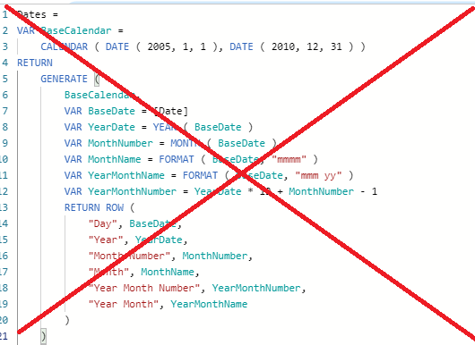
Prerequisites
Level 200 Session
Basic knowledge of Power BI would help
You don’t need to know any DAX !
@DataMozart

Slide 4
Agenda
Turn plain Matrix to a „custom“ visual
Show selected slicers in the report
Tooltip Pages + Animated Tooltips
Dynamic Filtering
Build custom Slicer pane with Bookmarks
Enhance report with images on axis
Reset all slicers with one click
@DataMozart

Slide 5

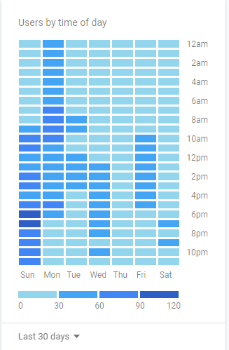
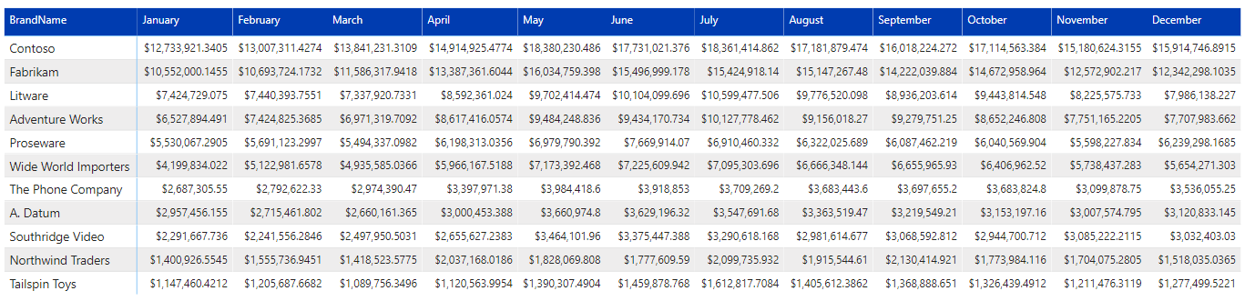
#1. TURN MATRIX TO „CUSTOM“ VISUAL
Challenge
Extremely large collection of visuals
Plain old Matrix from SSRS time
@DataMozart

Slide 6

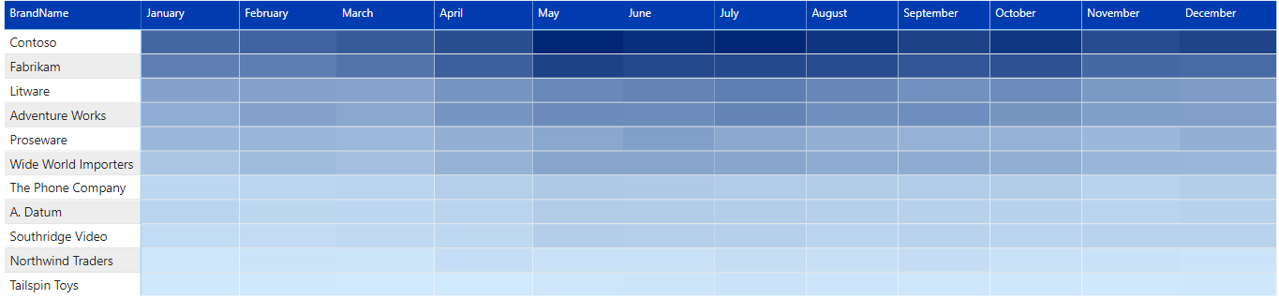
#1. TURN MATRIX TO „CUSTOM“ VISUAL
Solution
Use the power of conditional formatting!
Transform Matrix to a „heatmap-like“ visual
Easy spot trends!
@DataMozart

Slide 7

#1. TURN MATRIX TO „CUSTOM“ VISUAL
@DataMozart

Slide 8
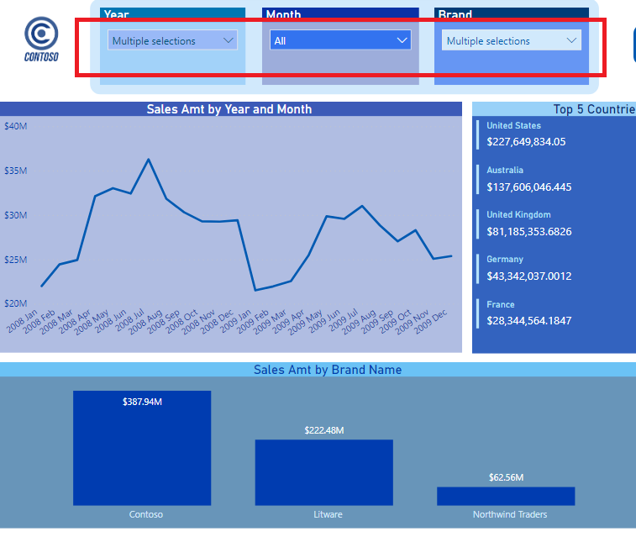
#2. SHOW SELECTED SLICERS
Challenge
Multiple slicers in the report
Multiple selections within one slicer
Enable users to see which filters they applied
@DataMozart

Slide 9
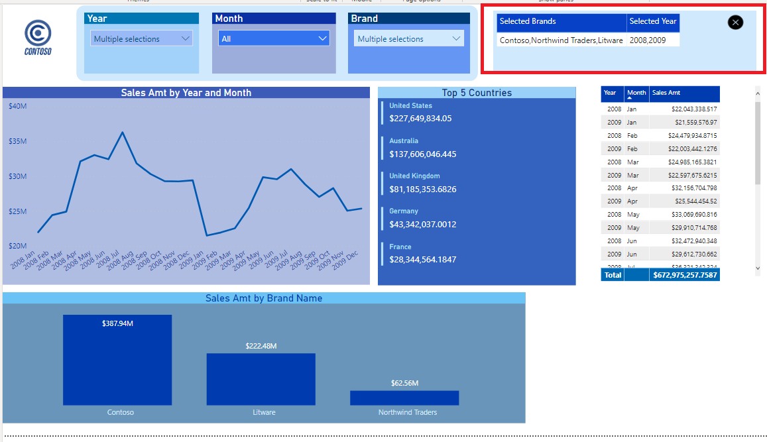
#2. SHOW SELECTED SLICERS
Solution
DAX is your friend!
Iterator functions to the rescue
Bonus tip: include bookmarks for even better user experience!
@DataMozart

Slide 10
#2. SHOW SELECTED SLICERS
@DataMozart

Slide 11
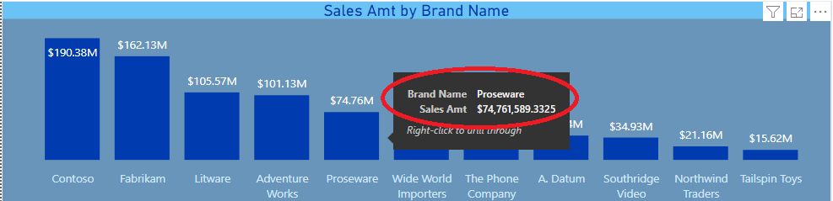
#3. TOOLTIP PAGES + ANIMATED TOOLTIP
Challenge
Default options are often not enough attractive?
How can we enhance user experience when using Tooltips?
@DataMozart

Slide 12
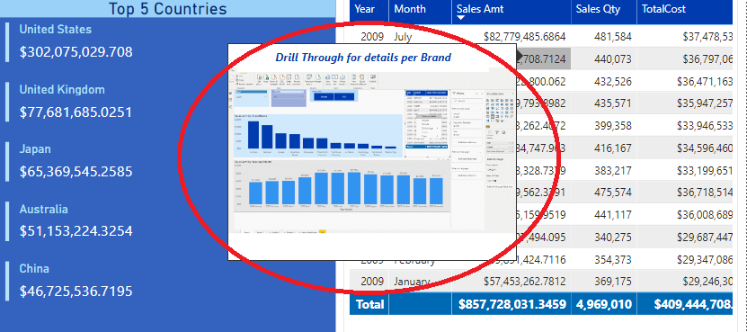
#3. TOOLTIP PAGES + ANIMATED TOOLTIP
Solution
Tooltip pages are a powerful way of communicating information!
Bonus Tip – create a fully animated Tooltip page!
Credits to Jason Cockington for the idea
Don‘t get crazy with creating too many of them !!!
@DataMozart

Slide 13
#3. TOOLTIP PAGES + ANIMATED TOOLTIP
@DataMozart

Slide 14
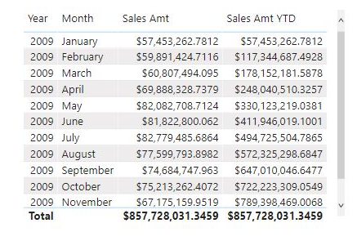
#4. DYNAMIC FILTERING
Challenge
Users choose what they want to see
Solution with buttons and bookmarks ?
What if we need multiple options to select from ?
@DataMozart

Slide 15
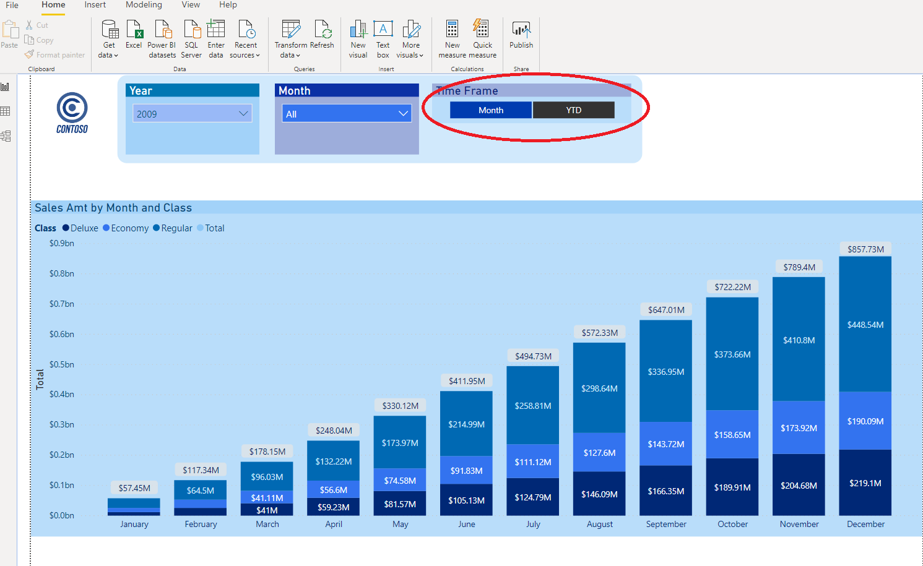
#4. DYNAMIC FILTERING
Solution
More flexible solution using simple techniques !
Faster development
Easily extendable and scalable
@DataMozart

Slide 16
#4. DYNAMIC FILTERING
@DataMozart

Slide 17
#5. BUILD SLICER PANE WITH BOOKMARKS
Bookmarks Overview
Bookmarks are one of the favorite features in Power BI
Many use cases
Gives your Power BI report an app-like experience
@DataMozart

Slide 18
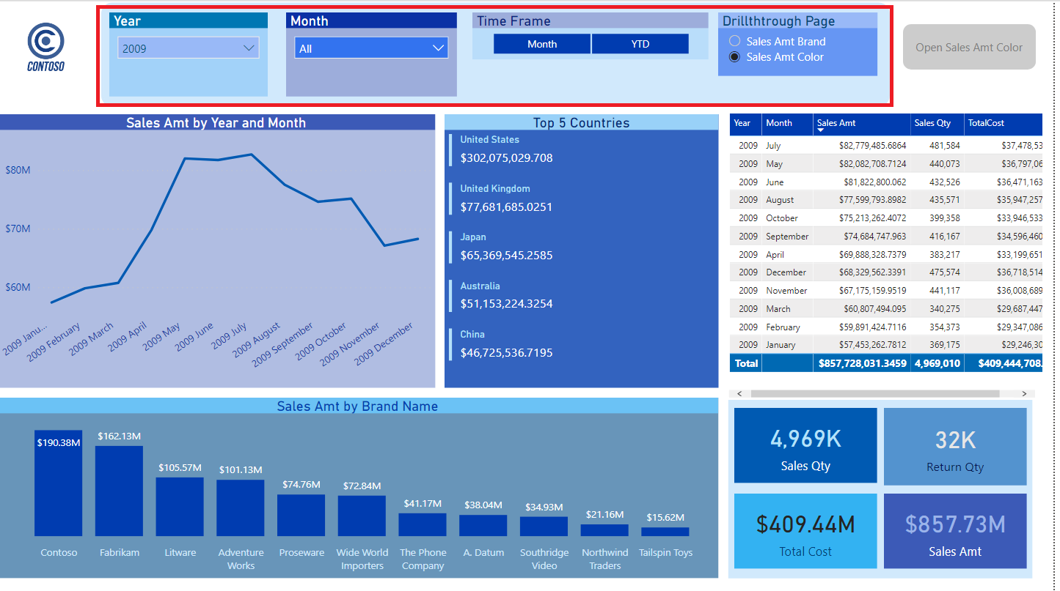
#5. BUILD SLICER PANE WITH BOOKMARKS
Challenge
What would you do in case your users need many slicers on the page?
Create separate page only for slicers ?
@DataMozart

Slide 19
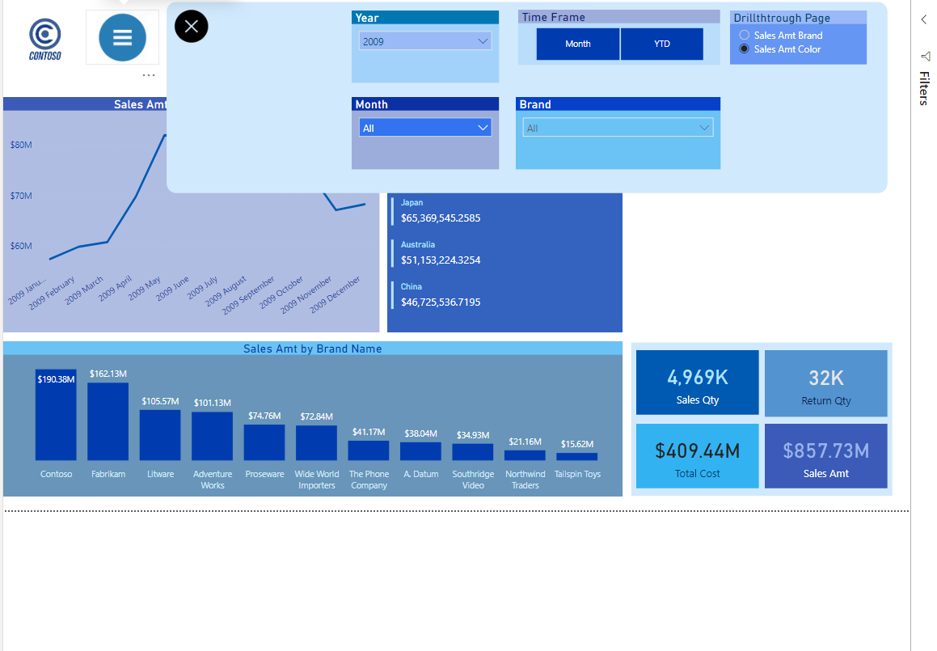
#5. BUILD SLICER PANE WITH BOOKMARKS
Solution
Powerful combination of bookmarks, buttons and actions will make you a hero!
Brings your Power BI report to a whole new level
@DataMozart

Slide 20
#5. BUILD SLICER PANE WITH BOOKMARKS
@DataMozart

Slide 21
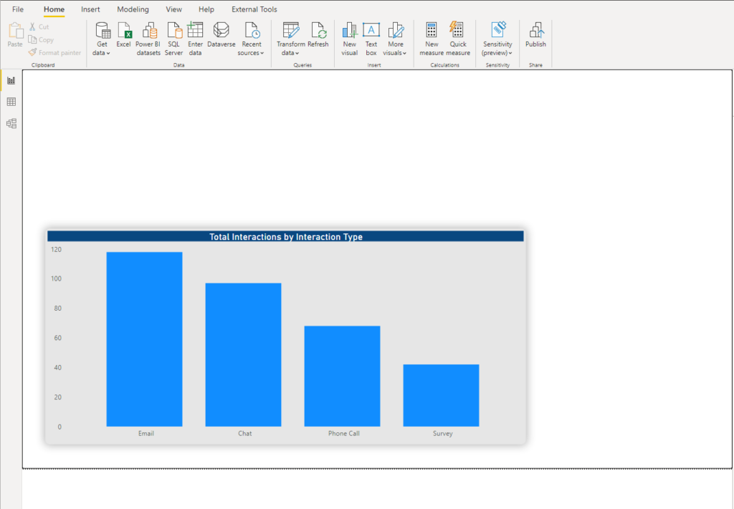
#6. ENHANCE REPORT WITH IMAGES ON AXIS
Challenge
Enhance regular built-in visualizations
Push user experience to a new level
@DataMozart

Slide 22
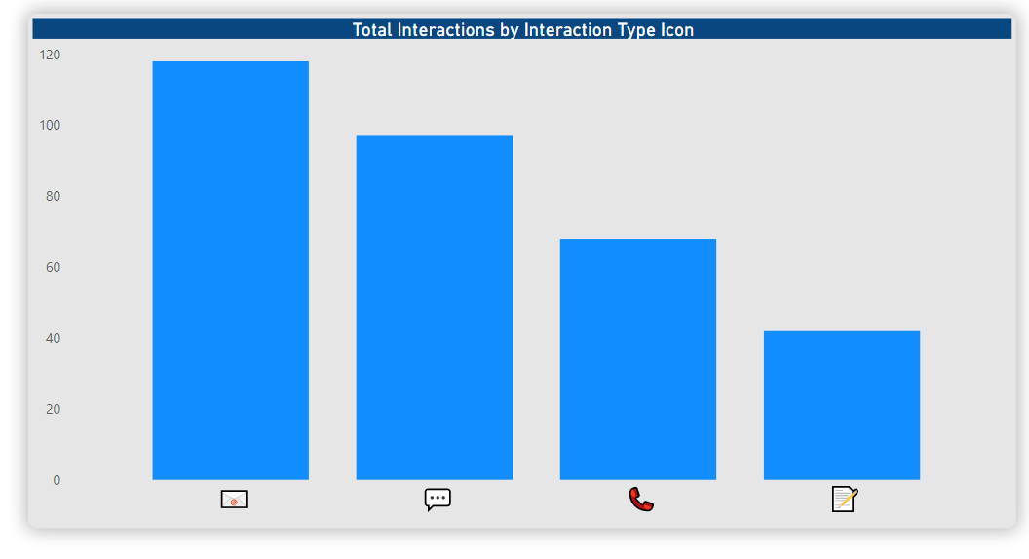
#6. ENHANCE REPORT WITH IMAGES ON AXIS
Solution
DAX (again) to the rescue!
UNICHAR function returns the Unicode character
Use your images on axis and slicers
@DataMozart

Slide 23
#6. ENHANCE REPORT WITH IMAGES ON AXIS
@DataMozart

Slide 24
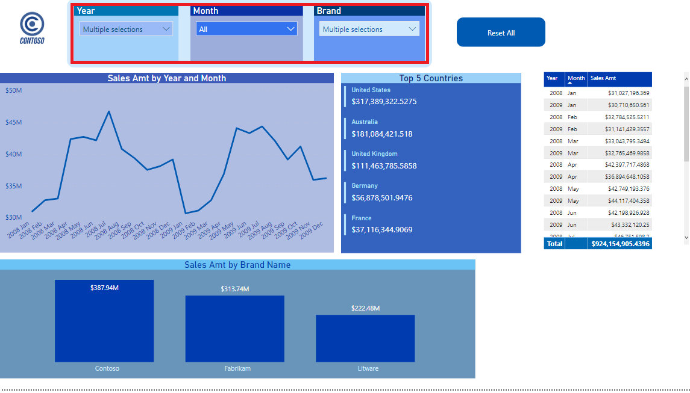
#7. RESET ALL SLICER WITH ONE CLICK
Challenge
Another use-case scenario for Bookmarks
Out-of-the-box solutions sometimes are not enough
Reseting all slicers one by one can be cumbersome
@DataMozart

Slide 25
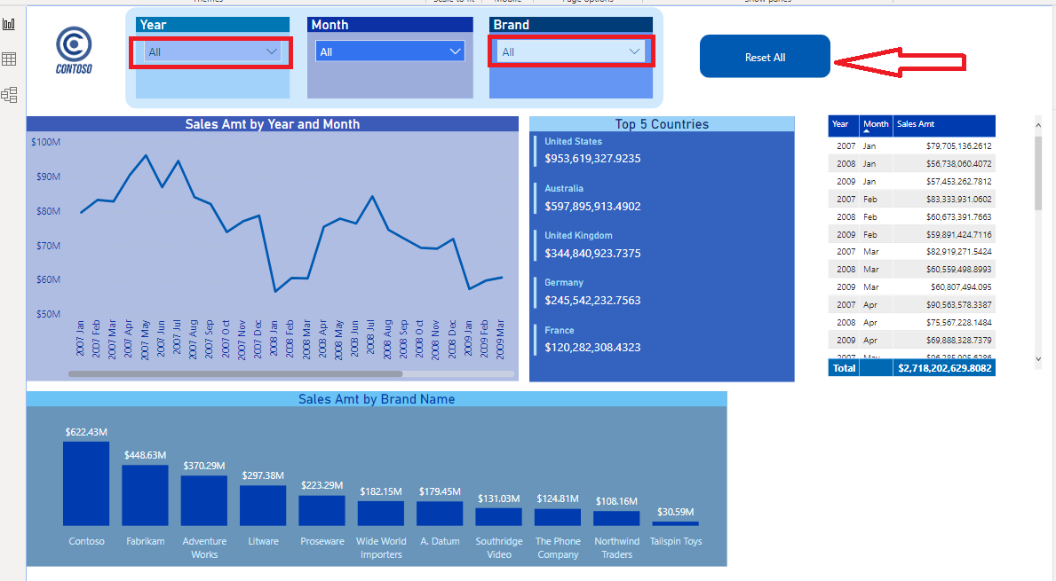
#7. RESET ALL SLICERS WITH ONE CLICK
Solution
Basic button solves the problem
Little tweakings sometimes bring great benefit!
Another use case of bookmarks
Don‘t forget to turn Data option ON!
@DataMozart

Slide 26
#7. RESET ALL SLICERS WITH ONE CLICK
@DataMozart

Slide 27
Questions ?
@DataMozart

Slide 28

Thank you!
Data-mozart.com
@DataMozart

